Slide 1
Greedy Strategy
A straightforward design strategy that can be applied to variety of problems
These problems have n inputs and a feasible solution is either a subset of n or a permutation (ordering) of n inputs that satisfies certain constraints.
There are many feasible solutions and getting one such feasible solution may not require much effort.
The feasible solution that maximizes or minimizes some objective function is called an optimal solution
The greedy method can be applied to solve optimization problems

Slide 2
There are two types of optimization problems
The solution is subset of n inputs where the order between the inputs is not important (subset paradigm)
The solution is a permutation of all n inputs or a subset of n inputs thus order is important (ordering paradigm)
Control abstraction for greedy algorithm for the subset paradigm
Algorithm greedy(a,n)
{ solution =φ
for i=1 to n do
{ x=select(A);
if feasible(solution , x) then
Solution = Union(solution, x)
}
return solution
}

Slide 3
Knapsack problem (fractional)
There are n objects and a knapsack or bag.
Object i has weight w_{i} and the knapsack has capacity m.
If a fraction x_{i} of, 0≤ x_{i} ≤ 1, of object I is placed into the knapsack then a profit p_{i}x_{i} is earned
Since the knapsack capacity is m, the total weight of all chosen objects can be at most m
∑ w_{i} x_{i} ≤ m 0≤ x_{i} ≤ 1
1≤ i ≤ n
The objective is to obtain a filling of the knapsack that maximizes the total profit earned.
maximize ∑ p_{i} x_{i}
1≤ i ≤ n
A feasible solution is any set(x₁,x₂,…x_{n}) satisfying the constraint ∑ _{1≤ i ≤ n} w_{i} x_{i} ≤ m and 0≤ x_{i} ≤ 1
An optimal solution is for which ∑ _{1≤ i ≤ n} pi xi is maximized

Slide 4
Example
n=3 m=20 (w1,w2,w3)=(18,15,10) (p1,p2,p3)=(25,24,15)
There are many feasible solutions
(x1 x2 x3) Total weight Total profit
(1/2, 1/3, 1/4) 16.5 24.25
(1, 2/15, 0) 20 28.2
(0, 2/3, 0) 20 31
(0, 1, 1/2) 20 31.5
In case sum of all the weights is ≤ m then xi=1 , 1≤ i ≤n, is an optimal solution
In case sum of all the weights is > m, then all optimal solutions will fill the knapsack exactly.
There are several Greedy approaches
Chose the object which yields highest profit-
Selection-Select objects in non-increasing order of profit
Feasibility-chose xi to ensure feasibility - as 1 if wi ≤ remaining capacity r else as the ratio of r/wi

Slide 5
Algorithm GreedyKnapsackprofit(P,W,m,n,X)
{ // arrays ordered in non-increasing order of profits
for i=1 to n do X[i]=0
r=m ; p=0 ; w=0;
for i=1 to n
{ if W[i] ≤ r then
{ X[i]=1;
p=p+P[i] ;
r=r-W[i] ;
w=w+W[i] }
else { x[i]=r/W[i] ;
p=p+ P[i]* r/W[i];
w=w + r;
return p}
} return p } This greedy strategy gives a suboptimal solution. Though profit increases at every step, knapsack capacity is used up rapidly
r=20 p=0 w=0
18 < 20
X[1]=1
p=25 r=2 w = 18
15 > 2
X[2]= 2/15
p=25+(2/15)*24=28.2 w=20

Slide 6
2. Chose the object which takes up the least capacity of knapsack –one with smallest weight
By being greedy about capacity we can earn more profits
Selection- select objects in non-decreasing order by weight.
Feasibility -chose xi as 1 if wi ≤ remaining capacity else chose xi as the ratio of remaining capacity by wi
Algorithm GreedyKnapsackweight(P,W,m,n,X)
{ // arrays ordered in non-decreasing order of weights
……………..// same as GreedyKnapsackprofit }
r=20 p=0 w=0
10 < 20
X[1]=1 p=15 r=10 w = 10
15 > 10
X[2]= 10/15 p=15+(10/15)*24=31 w=20
This greedy strategy also gives a suboptimal solution
Though capacities are used slowly, profits are not
increasing rapidly

Slide 7
3. Chose the object having maximum profit perunit of capacity
Selection-select objects in non-increasing order by the ratio pi/wi.
Algorithm GreedyKnapsackratio(P,W,m,n,X)
{ // arrays ordered in non-increasing order of pi/wi
……………..// same as GreedyKnapsackprofit }
(24/15,15/10,25/18)=(1.6,1.5,1.39)
r=20 p=0 w=0
15 < 20
X[1]=1 p=24 r=5 w = 15
10 > 5
X[2]= 5/10 p=24+(5/10)*15=31.5 w=20
It can be proved that this greedy strategy gives an optimal
solution

Slide 8
0/1 Knapsack problem
The additional constraint that xi=1 or xi=0, that is and object is either included or not included into the knapsack, fraction is not allowed
N=4 m =20 wi(16, 12 , 8, 6) pi( 32, 20, 14, 9)
1 greedy strategy ordered according to profit
1. (1,0,0,0) total weight=16 total profit=32
2 greedy strategy ordered according to weight
2. (0, 0,1,1) total weight=14 total profit=23
3 greedy strategy ordered according to pi/wi
( 32/16,14/8,20/12, 9/6)=(2, 1.75,1.67,1.5)
3. (1,0,0,0) total weight=16 total profit =32
Consider the feasible solution
(0,1,1,0) total weight=20 total profit =34
None of the greedy strategies give an optimal solution in case of 0/1 knapsack problem

Slide 9
Job Sequencing with deadlines
There are n jobs . With every job is associated a deadline di > 0and a profit pi.
The profit is earned if and only if job is completed before deadline
To complete a job, the job is to be processed on a machine for one unit of time. Only one machine is available for processing jobs
A feasible solution is a subset J of jobs such that each job in this subset can be completed by its deadline
There are many feasible solutions . All singleton sets are feasible solutions
Value of a feasible solution J is the sum of the profits of the jobs in J.
An optimal solution is a feasible solution with maximum value

Slide 10
Example
N=4 (p1,p2,p3,p4)=(50,10,15,27) and
(d1,d2,d3,d4)=(2,1,2,1)
Subset Processing sequence Value
  {1,2} 2, 1 60
  {1,3} 1,3 or 3, 1 65
  {1,4} 4,1 77
  {2,4} not feasible
  {3,4} 4,3 42
  {1,2,3} not feasible
  {1} 1 50
The objective of Greedy algorithm is to increase profit
Selection- select the in non-increasing order of profits
Feasibility-one way is to try all possible permutations of selected jobs to get one that does not violate deadlines -which is time consuming

Slide 11
Feasibility can be checked by using only one permutation of jobs –ordered in non-decreasing order of deadlines
If this permutation violates deadlines, then no other permutation can satisfy deadlines
The greedy algorithm thus obtained always gives an optimal solution
Algorithm JobScheduling(D, J, n)
// jobs are in non-increasing order of profits
{D[0]=J[0]=0;// sentinel for insertion
J[1]=1; // include the first job
k=1; // no of jobs included
for i=2 to n do
{ r=k; // search for a position for ith job in 1 to r
//if the deadline of job at rth position equals r it cannot be //pushed down also for insertion deadline of ith job //should be less than job at rth position
While D[J[r]] >D[i] and D[j[r]] ≠r do r = r-1

Slide 12
//the job is to be now inserted at r+1 th position only if its
//deadline is greater than r and greater than the Job at r
if( D[J[r]]<=D[i] and D[i] >r then
{ // insert job by pushing down jobs to create space for //insertion
for q=k downto r+1(**q = k; q>=r+1 ;q--) do J[q+1]=J[q]
J[r+1]= i
k = k+1
}
} return k
}
The worst case computing time of the algorithm is θ(n²)
Better computing time can be obtained by postponing processing of job as much as possible
Divide the time into b slots where b=min { n, max{ di }}
For job i find the slot closest to its deadline that is free and allot it, if none such slots are free job is rejected

Slide 13
Example: N=5 (p1,p2,p3,p4,p5)= (20,15,10,5,1) and
(d1,d2,d3,d4,d5)=(2,,2,1,3,3)
There are initially three slots(3= min(5, max{di}))
[0,1], [1,2] and [2,3] and all are free
The jobs are ordered in non-increasing order of profits
Selected job deadline slot allocation action taken profit
1 2 [1,2] is free assigned 20
2 2 [1,2] not free
[0,1] is free assigned 15
3 1 [0,1] not free
no more slots rejected 0
4 3 [2,3] is free assigned 5
5 3 [2,3] not free
[1,2] not free
[0,1] not free
no more slots rejected 0
Total profit earned =40

Slide 14
The algorithm can be implemented by using an efficient data structure disjoint set with unions
Data structure Disjoint set union
Sets of elements which are pair wise disjoint, i.e, if Si and Sj are two sets, then there is no element that is both in Si and Sj.
Ex S1={1,3,5} S2={2,8,10} S3={4,6,7,9}
Each set can be represented as a tree with each node stores a link to its parent. One of the nodes can be a parent
1
2
4
3
5
8
10
6
7
9
S1
S2
S3
1
2
4
3
5
8
10
6
7
9

Slide 15
The operations to be performed on disjoint set
1. Disjoint set union – If Si and Sj are two disjoint sets , then the union Si U Sj is the set of all elements in Si and Sj
Ex S1={1,3,5} S2= { 2,8,10} S1Us2={1,3,5,2,8,10}
1
Make one of the trees a subtree of the other
Set the parent field of one of the roots to other root
2
3
5
8
10
2. Find - Given the element i find the set containing i.
The performance of find and union can be improved by avoiding the creation of degenerate trees.

Slide 16
Weighting rule-If the number of nodes in the tree with root i is less than the number in the tree with root j, then make j the parent of i otherwise make i the parent of j. It is applied during union operation
Without weighting rule With weighting rule
1
2
n
1
2
n
1
1
1
1
1
2
2
2
2
2
3
3
1
n-1
2
3
n
n
With weighting rule the worst case height of the tree with m nodes is log ₂m +1
1
3
5
3
1
1
5
2
7
4
3
6
4
2
8
7
2
4
6
8

Slide 17
Collapsing rule-If j is a node on the path from i to its root and p[i] (parent of i) is not equal to root[i], then set p[j] to root[i]-Collapsing rule is applied during find operation
1
First Find(8) requires going up three parent links and then two links are reset
3
5
2
4
7
6
8
1
Remaining Find(8)s will require only going up one link
3
5
2
4
8
7
6
The weighted unions and collapsing almost double the time required for individual find but reduce the time for subsequent finds.

Slide 18
The effect of a collapsing find operation. After the find, all the nodes along the search path are attached directly to the root.
That is, they have had their depths decreased to one. As a side-effect, any node which is in the sub tree of a node along the search path may have its depth decreased by the collapsing find operation.
The depth of a node is never increased by the find operation.
The time complexity of weighted union and collapsing finds is much better than log₂n
Disjoint set with weighted unions and collapsing finds is a good data structure

Slide 19
Algorithm FastJobScheduling(D, J, n, b)
{for i=0 to b do p[i]=i // initialize
k=0;// the number of jobs selected
for i=1 to n do
{q = collapsingFind(min(n, D[i]))
if p[q] = 0 then write(“rejected”)// if it is root
else {
k=k+1; J[k]=i //select job i
m=CollapsingFind(p[q]-1)
Weighted Union(m, q)
p[q]=p[m]; //q may be new root
}
}//end of for
}

Slide 20
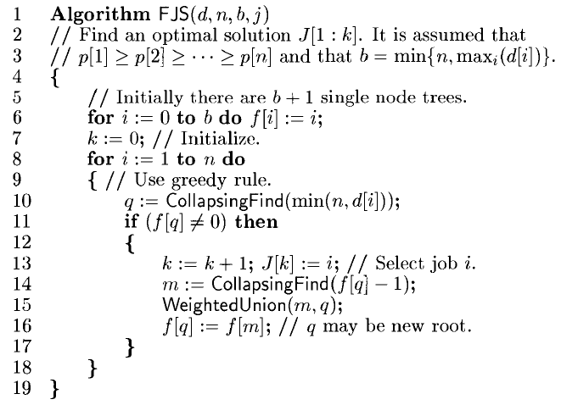

Slide 21
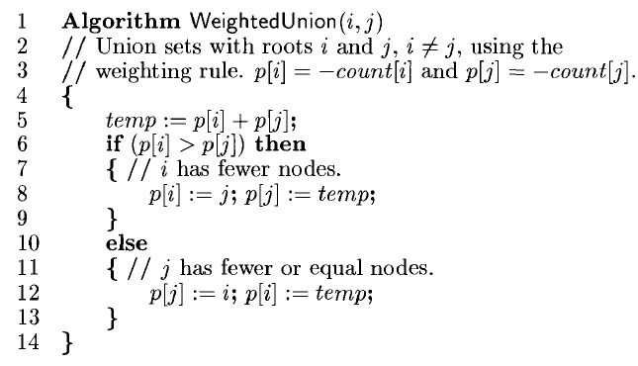

Slide 22
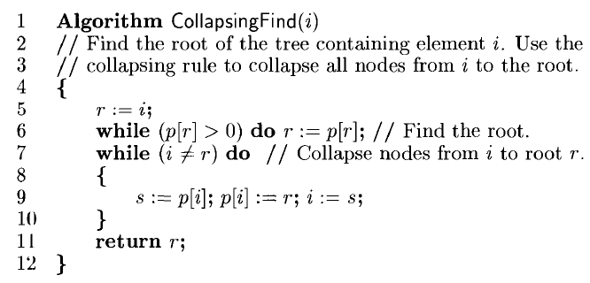

Slide 23
Optimal Merge patterns
Two sorted files containing m and n records can be merged together to get a sorted file in O(m+n)
If there are n files to be merged, there are several possible orders in which merging can take place with different associated costs
Ex n =3 files of size 20 , 30 and 10
[ [1 2] 3] 20+30=50 50+10=60 Total 110
[1 [2 3]] 30+10=40 20 +40=60 Total 100
[[1 3] 2] 20+10=30 30 +30=60 Total 90
The above merge patterns are two way merge patterns and can be represented in the form of binary merge trees
The leaf nodes represent files and are called external nodes
60
50
10
20
30

Slide 24
The internal nodes represent files obtained by merging files represented by its children O(m+n) . The number in node is the length of the file
The root represents the final file obtained after merging
If di is the distance from root to an external node of length qi then the total number of moves for binary merge tree is ∑ diqi .
This sum is called the weighted external path length of the tree
60
2(20)+2(30)+1(10)=110
50
10
20
30
2(20)+2(30)+2(10)+2(40)=200
100
50
50
20
30
40
10

Slide 25
The optimal two way merge pattern corresponds to a binary merge tree with minimum weighted external path length
The greedy approach is at every stage select the two smallest files and merge them. The new file obtained is a used in subsequent merges
Each file is a tree node with left child , right child and weight which is the file length
The tree nodes are maintained as a list with two operations
Least(list) –returns the smallest element
Insert(list, t)- inserts the tree node in the list

Slide 26
Algorithm OptimalMergePattern(list, n)
{ for i=1 to n-1 do
{
new->lchild=Least(list) ;
new->rchild=Least(list) ;
new->weight=((new->lchild)->weight) + ((new->rchild)->weight) ;
Insert(list, new);
}
return Least(list) ;
}

Slide 27
Example
N=6 file sizes are
28, 32, 12, 5, 84, 42
List contains
5
12
28
32
42
84
17
28
32
42
84
5
12
32
42
45
84
17
28
5
12

Slide 28
45
74
84
17
28
32
42
5
12
84
119
45
74
17
28
32
42
5
12

Slide 29
203
84
119
45
74
17
28
32
42
5
12
If list is kept in non-decreasing order according to weight
Least(list) requires only O(1) time while insert(list,t) will take O(n) time . The algorithm will be of O(n²)
The list can be maintained as priority queue with Least as delete operation and usual insert operation on priority queues.
If priority queues are maintained as heaps then the both operations are of O(logn)
The running time of algorithm will be O(nlogn)

Slide 30
Huffman Codes
Huffman codes are widely used and very effective technique for compressing data
Coding is representing each character by a binary string called codeword
Two types of codes
Variable length codes
Fixed length codes
A variable length code can considerably reduce the message size by giving frequent characters short codeword and infrequent characters long codeword
a b c d
Frequency 100 20 30 5
Fixed length encoding 00 01 10 11
Variable length encoding 0 10 110 111

Slide 31
Message aabbbaaaacaacad
Fixed length encoding 15x2=30
Variable length 9+6+9 =24
Prefix codes are codes in which no codeword is also a prefix of some other codeword
Prefix codes are used because they simplify encoding (compressions) as well as decoding
Huffman used a greedy approach that uses table of frequency of occurrence of each character to build an optimal way of representing each character as a binary string(codeword)
The decoding process needs a convenient way of representing the prefix codes
A binary tree is constructed using merge operation same as in optimal merge patterns whose leaves are given character frequencies.

Slide 32
The binary codeword for a character is the path from the root to that character where 0 means go to the left and 1 means go to right
Ex n=6 Messages with frequencies 4 ,5 ,6 ,8, 10, 12
4
5
6
8
10
12
6
8
9
10
12
4
5
9
10
12
14
4
5
6
8
12
14
19
9
10
6
8
4
5

Slide 33
19
26
9
10
12
14
4
5
6
8
45
0
1
0
19
1
0
26
1
0
9
10
12
14
1
0
1
4
5
M3
M4
6
8
M1
M2
M6
M5
M1= 000 M3=01 M5 = 110
M2=001 M4= 10 M6 = 111

Slide 34
Obtain set of Huffman codes for the messages (m1,m2,m3,m4,m5,m6,m7) with relative frequencies(f1,f2,f3,f4,f5,f6,f7)= (1,1,2,3,5,8,13).

Slide 35
Optimal storage on tapes
There are n programs that are to be stored on a tape of length l. Associated with each program is a length l_{i}, 1≤ i ≤ n. all programs can be stored if sum of the lengths of the programs is at most l.
If the programs are stored in order I= i₁,i₂…..i_{n}, the time t_{j} needed to retrieve program i_{j} is proportional to ∑_{1≤ k ≤j} l_{ik}
(l₁+l₂+…+l_{j})
If all programs are retrieved equally often , then the expected or mean retrieval time MRT is 1/n∑_{1≤ j ≤n} t_{j}
The optimal solution is looking for a permutation of n programs that minimizes MRT
The greedy method requires to store the programs in non-decreasing order of their lengths
The greedy algorithm reduces to an efficient sorting algorithm

